Slide 1
Community Sensor Lab: V2.0
featherwing
featherwing
OLED
display + buttons
RTC real time clock
PCF8523
i2c : 0x68
feather M0 Wifi
i2c : 0x3C
Micro SD
memory card
#10 cs
u-controller
ATSAMD21G
#9* button A
#6 button B
#5 button C
SPI
#2 en
#4 rst
#7 irq
#8 cs
* pin #9 is Vbat.
Disable pull-up to read analog.
Set pull-up for button.
SPI
SPI
MISO, MOSI, SCK common
+ CS dedicated DIO pin
SPI
i2c : 0x68
Wifi
WINC1500
#11 cs
SCL, SDA common + address
#10 cs
connected DIO pin 10
i2c : 0x61
i2c :
0x76 or 0x77
i2c : 0x69
Sensirion
SCD30
CO2
BME280
T P RH
Sensirion
SPS30
PM2.5
Honeywell
HSC differential pressure sensor
Special for Met Museum

Slide 2
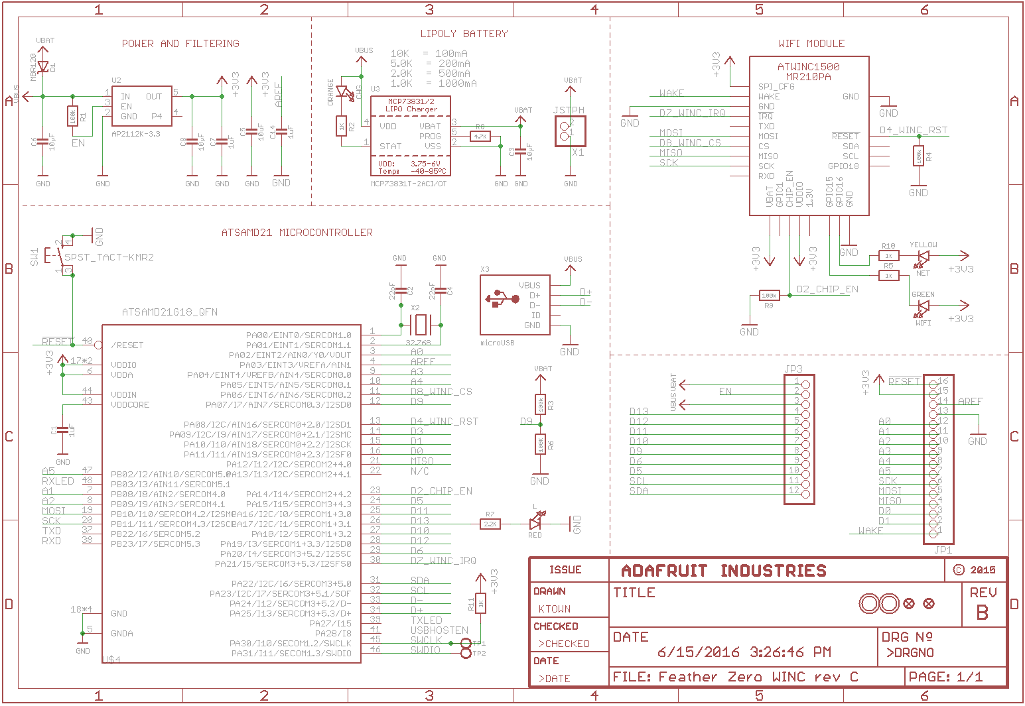

Slide 3
